Slide 1
Neonatal Resuscitation – Minimally Invasive Approach
Neil Finer
Professor Emeritus
Division of Neonatology
UCSD Medical School

Slide 2
Conflicts of Interest - N Finer
Dr. N. Finer is a paid consultant for Fisher& Paykel

Slide 3
Delivery Room Resuscitation
One and two and three and Breathe !

Slide 4
When does Resuscitation Begin?
Delayed Cord Clamping
Placental blood is the babies blood
Safest blood to give to the infant and easiest
There was a concern that early clamping reduced PPHemorrhage
Recent analyses demonstrate that in Term infants delayed clamping is associated with higher hemoglobin ( + 2.17 g/dl) for up to 6 months and better iron stores, and more need for phototherapy
No change in PPH
McDonald and Middleton, Cochrane Review 2009

Slide 5
Delayed Cord Clamping and Preterm Infants
Rabe et al Cochrane Review 2012
Reviewed studies in preterm infants from 24 to 36 weeks
Delay from 30-180 seconds
Delayed/Milked group needed fewer transfusions for anemia, and had less IVH and NEC, but had higher peak bilirubin concentrations

Slide 6

Evidence supports delayed umbilical cord clamping in preterm infants.
European Consensus guidelines recommend a 30-45 second delay before clamping ( Sweet, 2010)
The single most important benefit for preterm infants is the possibility for nearly 50% reduction in intraventricular hemorrhage.
Raju T, Number 543, December 2012

Slide 7
Time of Cord Clamping – Delaying is much less invasive!!
AAP has endorsed the use of a delay before clamping for preterm infants whenever feasible, and for infants who do not need resuscitation (http://aapnewsde.aap.org/aapnews-open/201304_o/?pg=17#pg17)
However, how do we know at birth if the infant needs resuscitation- I think most of these infants would benefit from the transfusion which is after all fetal blood of up to 30-40ml/kg
Immediate cord clamping never proven to be beneficial by any controlled trials!!

Slide 8
Delayed Cord Clamping and Premature Delivery – Ongoing trials
Australian Placental Transfusion Study – will enroll 1600 infants < 30 weeks - Immediate Clamping vs 60 seconds
Composite outcome = death and/or major morbidity at 36 weeks defined by one or more of the following: Brain injury on ultrasound, Chronic lung disease, Severe retinopathy, Necrotising enterocolitis, Late onset sepsis
Currently 50% complete.
Will evaluate 2 year Neurodevelopmental Outcome

Slide 9
Current Use of Placental Transfusion in USA - Jelin AC et al. Obstetricians' attitudes and beliefs regarding umbilical cord clamping. J Fetal-Maternal-&Neonatal Med 2013
Only 12% of responders had an umbilical cord clamping policy.
The most frequent response for lack of a policy for optimal timing of umbilical cord clamping, was “don’t know.”
Only cited reason for a delay was the potential for neonatal red blood cell transfusion
The reason to clamp the cord immediately was the risk of delaying neonatal resuscitation!!

Slide 10
Immediate vs Delayed Clamping and Ventilation: Bhatt et al J Physiol 2013;591;2113
Studied lambs (123 days) with catheters and probes in pulmonary and carotid arteries
Lambs were delivered at 126±1 days and:
Clamp 1st -ventilation was delayed for about 2 min (Clamp 1st; n = 6),
Vent 1st - umbilical cord clamping was delayed for 3–4 min, until after ventilation was established

Slide 11
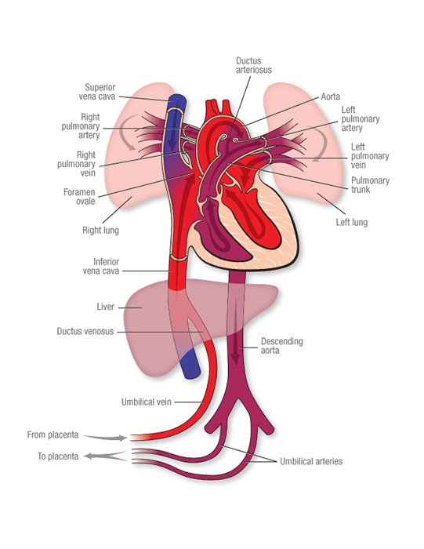
Immediate Clamping
Associated with immediate afterload to R and L Ventricle and decreased
R & L Preload
Associated with decreased HR and CO
Increases PVR and decreases PBF
Associated with Increased Carotid artery pressure and decreased blood flow
All may contribute to IVH!
Cord Clamp

Slide 12
Immediate Clamping and fall of HR and RVO- Bhatt et al
Heart rates markedly decreased within 120 s of cord clamping in unventilated animals and recovered after ventilation.

Slide 13
Delayed Clamping and Early Ventilation -Bhatt et al J Physiol 2013
Immediate Cord clamping resulted in a rapid transient increase in carotid artery pressure, with decreased carotid flow, which then improved over the next minute. Not seen in Vent first animals!

Slide 14
Delayed Clamping and Early Ventilation -Bhatt et al J Physiol 2013
Delayed clamping until after ventilation was initiated maintained HR, and carotid pressure and flow
If Ventilation precedes cord clamping, there is secondary increase in PBF and RVO that persists for at least 30 min after birth.
Abolishes the adverse changes and smooths hemodynamic transition

Slide 15
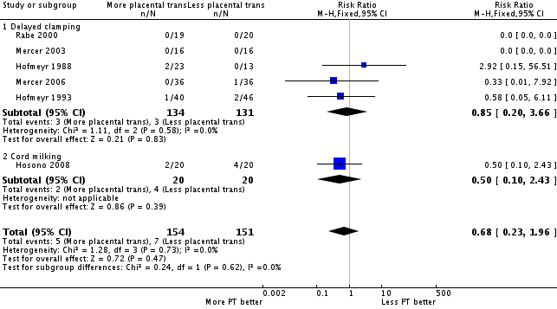
Subgroup analysis (Delayed Clamping and Cord Milking) : Severe Intraventricular Hemorrhage
Rabe H et al Cochrane Database Syst Rev. 2012 Aug 15;8:CD003248.

Slide 16
PREMOD: PREmature infants receiving Milking Or Delayed Clamping - Katheria et al
NICHD funded Pilot Study – Sharp Mary Birch Hospital for Woman San Diego
Primary Hypothesis: Milking will improve SVC flow in VLBW infants born by C/S compared to 45 second delay clamp
N= 197 infants (152 C-section, 45 Vaginal)
Milked infants had better Hemoglobins, BP over first 24 hrs, better SVC flow and better RVO
Notes:
So we developed a trial of Milking vs. DCC with a proimary hypothesis that Milking improved SVC flow

Slide 17

Blood Pressure Premod.
Milked
Delay
Notes:
Here is the graphic of differences in Mean Blood pressure.

Slide 18
Best and First Least Invasive Practice
Provide adequate placental transfusion
If the infant is deemed to need immediate resuscitation – How do we determine this while infant still attached to placenta???- initiate stabilization while still attached to a pulsating cord to open lung and facilitate receipt of placental transfusion (If possible - needs to be proven!)
[http://clinicaltrials.gov/NCT02231411 Katheria et al]
or
Consider Milking and deliver

Slide 19
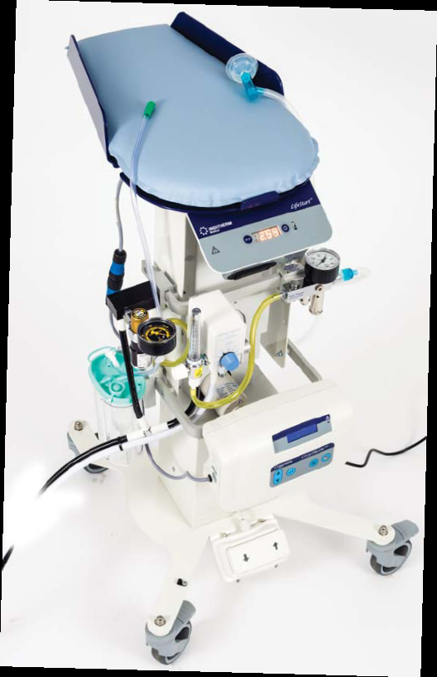
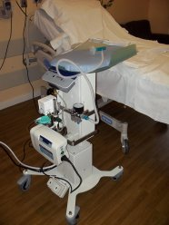

Slide 20
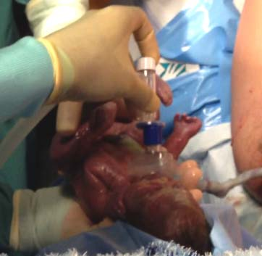

Slide 21
Excessive Facial Pressure Results in Bradycardia
Pulse Rate
SpO₂
Mask On Off On Off
Seconds (X2)

Slide 22
Can a Pulse Oximeter Provide Useful Data within 1-2 minutes of Birth?
Gandhi et al, PAS – EPAS2012:4525:344
Retrospective review (June 2010 to December 2011, 50 Preterm Infants
SpO2 values recorded at 1 sample per second (Masimo).
Mean and median time to achieve functioning pulse oximetry was determined.
Gest - 23-35 weeks, BW -360-1445g

Slide 23
Time when Reliable SpO2 Signal Obtained
Mean = 79 ± 42 seconds
(range 40-240 s)
Median = 67 seconds
(interquartile range 50 – 93 s)

Slide 24
Time Distribution to working SpO2

Slide 25
Pulse Oximetry – Limitations!!
Now a standard but not easy to get reliable readings before 90 sec and sometimes longer
They probably provide less than accurate readings for initial minute(s)
The Oximeter HR reads somewhat lower than gold standard – ECG but most do not use!
This difference is probably not critical!

Slide 26
Heart Rate Monitoring: UCSD Practice
Auscultation
Continuous Display
Pulse oximeter
EKG leads
  Use for crash CS or known severe fetal compromise
  Use when unable to determine HR by other methods

Slide 27
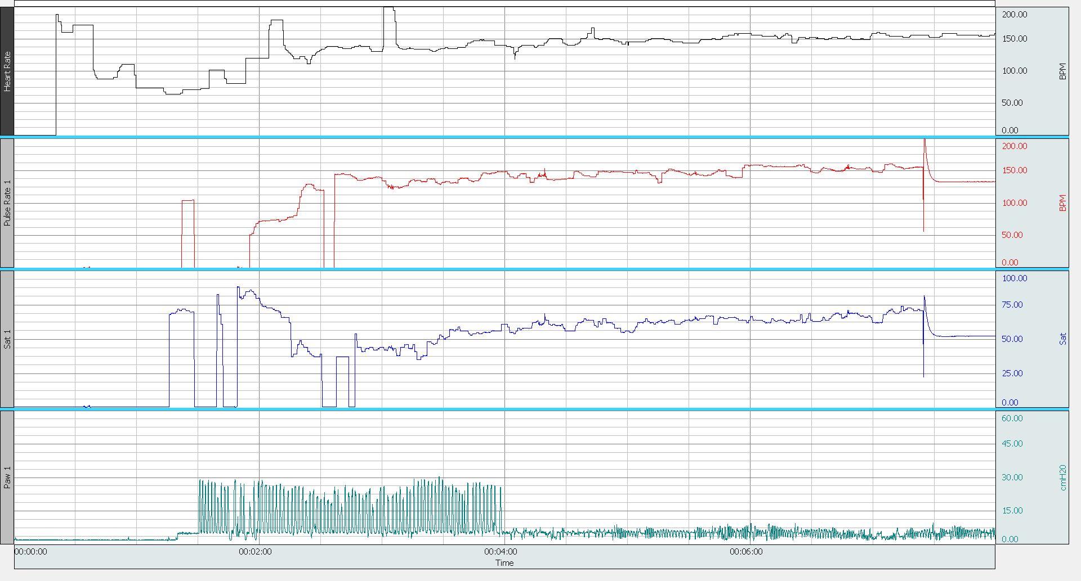
ECG from Chest electrodes
Applied
HR from Oximeter

Slide 28
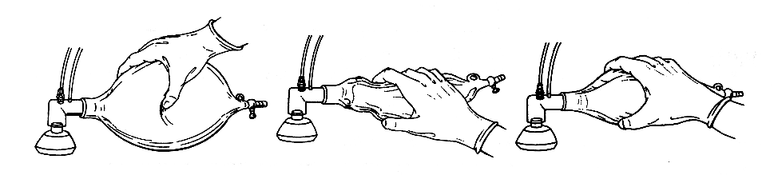
Bag and Mask Resuscitation:
A Moving Experience!!
Ensure adequate seal over mouth and nose
Use adequate pressure to inflate chest
Both Bag and chest should move
Commonest problems – leak and airway obstruction

Slide 29
Does Achievement of Target PIP during Bag and Mask Ventilation Equate to adequate Ventilation??
O’Donnell et al Arch Dis Child Fetal Neonatal Ed. 2005; 90(5):F392-6.
How do you know you are ventilating the infant?
Evaluated bagging on a manikin using expired Vt
There are large leaks around the face mask.
Airway pressure is a poor proxy for volume delivered during positive pressure ventilation through a mask.
We were concerned that we are not ventilating the infant with every pressured breath!!

Slide 30
Chest Rise as Indicator of Delivered Tidal Volume during Resuscitation-
Resuscitation 2011;82:175
Arch Dis Child Fetal Neonatal 2010;95:393
Performed 2 studies to compare operators assessment of Vt delivered by face mask from Chest Movement compared to delivered Vt
Compared looking at infant from head or beside infant
No good correlation found
For No Vt at all – Actual Vt = 8.3ml/kg
For “not sure” – Actual Vt = 8.6 ml/kg
Estimated Vt was underestimated by > 3.0ml

Slide 31
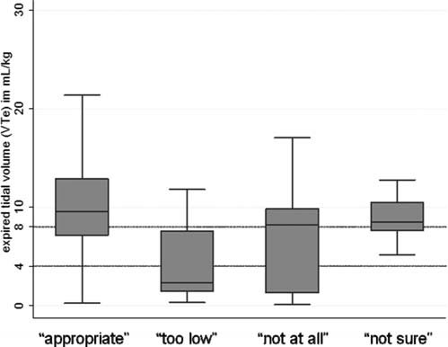
Schmoelzer et al Arch Dis Child Fetal Neonatal 2010;95:393
Chest Rise vs Measured Vt during Resuscitation in Preterm Infants
Figure 4 Comparison of expired tidal volume with the operator estimates of chest rise. The horizontal lines show the range of V Te which would provide reasonable ventilation. The y axis represents V Te in ml/kg and the x axis operator estimates of chest rise. The box plots show median values (solid bar), IQR (margins of box) and 95% CI.

Slide 32
Determination of Adequate Ventilation during Resuscitation
We were concerned that achieving adequate PIP during bagging would not necessarily lead to an adequate delivered breath
Previous work confirmed that reaching PIP was not adequate evidence of an effective breath!
We wanted to avoid complicated instrumentation
We looked for a simple method – PediCap was being used to confirm intubation

Slide 33
Confirming Airway Patency during Bagging
Leone et al Pediatrics 2006:118;E202-4
You need an effective breath and a perfused lung!!
No color change forces the team to recheck for airway patency
One Manufacturer now adding such a colorimetric strip to baggers

Slide 34
Failure of Adequate Bagging
Airway obstructed: commonest causes are
  Tongue against pharyngeal wall
  Closure of larynx following central apnea
  Muscle rigidity following fentanyl?
Airway Obstruction – Can create pressure in bagger without gas exchange or chest wall movement
Difficult to appreciate at bedside

Slide 35
Confirming Airway Patency during Bagging
Leone et al Pediatrics 2006:118;E202-4
We started using the Colorimetric CO₂ detector during bagging
It will change color if CO₂ is detected
This is semi-qualitative
You will only get CO₂ if gas from the lung is detected and there is pulmonary perfusion!!!

Slide 37
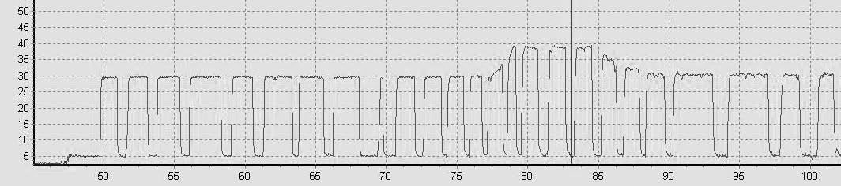
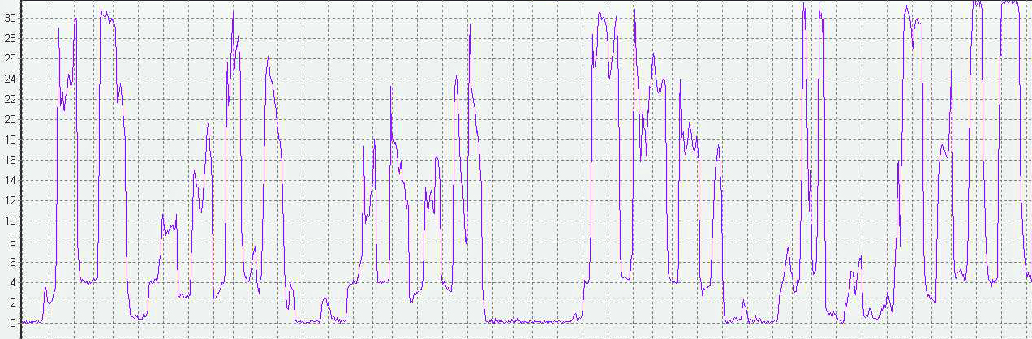
Finer et al, Pediatrics 2009;123:865
A B C
Top Tracing - Mask Applied, No PediCap® color change till B - Airway pressure
increased by operator, Pedicap Changed color at C
Bottom Tracing - Target pressure not being reached with a pressure plateau,
and probably represents a significant air leak, no PediCap® color change observed.

Slide 38
Airway Obstruction during PPV
Finer et al, Pediatrics 2009;123:865
24 VLBW patients reviewed with adequate data
6 had no evidence of color change
Of remaining 18, there were a median of
14 obstructed initial breaths
(4-37, 10-220 seconds duration)

Slide 39
Change in HR over Time, N=46.
Blank et al, Resuscitation 2014 Sep 15
*
*
*
* p <0.001
Seconds
Notes:
A repeated measures ANOVA determined that heart rate differed significantly between time points (F( 5,225) =41.38, P<0.0005). Post hoc tests using the Bonferroni correction showed that heart rate after Gold color change was significantly higher than the heart rate prior to Gold color change. The mean heart rate prior to Gold color change was significantly less than 100 (87 BPM, 95% CI, 79 to 96 BPM at 20 seconds prior to Gold color change, and 87 BPM, 95% CI, 78 to 96 BPM at 10 seconds prior to Gold color change). The mean heart rate 10 seconds after Gold color change was significantly greater than 100 BPM. (115 BPM, 95% CI, 105 to 125 BPM).

Slide 40
Volume Monitoring in DR
Technology available and reasonably simple using hot wire devices
Adds dead space and resistance
Need education to recognize real exhaled volume and calculation of leak
Newer and simpler devices are being produced to simplify these observations

Slide 41
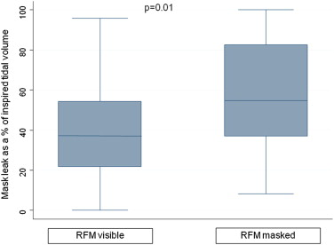
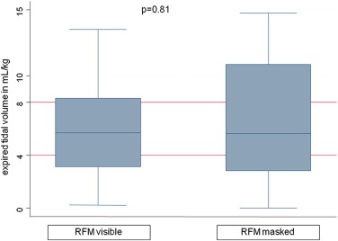
Respiratory Function Monitor during Resuscitation
Schmoelzer at el, J Pediatr 2012;160:377-81
Percent leak Expired Tidal Volume

Slide 42
Airway Obstruction and Leak during PPV
Schmoelzer et al, Arh Dis Child Fetal Neonatal Ed 2011 Jul;96(4):F254-7
Used Respiratory Function monitor
Reported obstruction in 26% beginning at mean of 46 sec, and lasting for a median of 22 breaths – up to 83 consecutive inflations!!
Leak noted in 51% usually starting with first attempted inflation
A median (range) of 10 (3-117) consecutive inflations with a leak >75% were delivered.

Slide 43
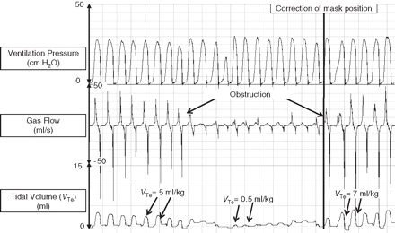
Airway Obstruction and Leak during PPV
Schmoelzer et al, Arch Dis Child Fetal Neonatal Ed 2011 Jul;96(4):F254-7

Slide 44
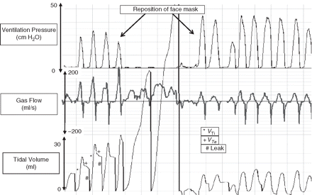
Airway Obstruction and Leak during PPV
Schmoelzer et al, Arch Dis Child Fetal Neonatal Ed 2011 Jul;96(4):F254-7

Slide 45
Current Controversies in Resuscitation
Sustained Inflations
TePas et al use longer breaths – 10 sec but study methodology problem –compared with SIB without PEEP! (Pediatrics. 2007;120:322-329)
European Guidelines recommend the use a prolonged inflation of 3-5 seconds before increasing the inspiratory pressure.
Recently demonstrated that SI are ineffective if infant apneic - Von Vonderon et al, J Pediatr 2014

Slide 46
Current Controversies in Resuscitation
Sustained Inflations
SIs very effective in intubated infant
In other situations when delivering with a mask their effectiveness remains to be proven
They may be associated with increased air leaks
Large study about to begin
I would use for infants unresponsive to PPV with continuing bradycardia and/or desaturation and try to limit to 30 cm and 5-10 seconds duration

Slide 47
Neonatal Resuscitation:
The Environment
We cannot change the human condition but we can change the conditions under which we work
Reason BMJ 2003;320:768-70

Slide 48
Leader and Team Problems during Videotaped Resuscitations at UCSD
More than 1 person doing single task (drying)
Nobody giving heart rate
Nobody assisting with O₂ during intubation
Nobody calculating duration of intubation attempt
Nobody providing cricoid pressure
No one coordinating compressions and ventilation
No Obvious Leader!!

Slide 49
Preparation for Resuscitation –
Led us to Develop a Checklist
Choose a leader
Review relevant NRP guidelines ( ie Meconium)
Review each members task(s)
Prompt and Support individuals with positive feedback
Provide objective input (duration of intubation, coordination of compressions and ventilation)
Debrief following with constructive comments

Slide 50
Pre-Resuscitation Checklist
Review each team members role
Discuss any special circumstances – CDH, Anomalies, ELBW etc
Check equipment – and special needs – transilluminator, video laryngoscope, etc
Encourage direct dialogue, and acknowledgement!!
Prepare and Include family if present and have staff

Slide 51


Slide 52
Communication
A pre-brief should include a specific statement, to be read every time, which encourages everyone that if they see something they are not comfortable with, they communicate it to the leader

Slide 53
Post Briefing
Quick huddle in NICU or DR
What did we do well?
What did we
do poorly?
What can we
do better?

Slide 54
Thank you for
your attention!

