Slide 1
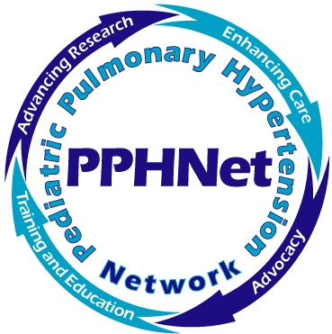
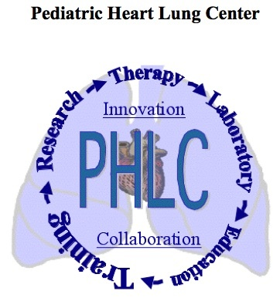
Pulmonary Vascular Disease in Bronchopulmonary Dysplasia
Steven H. Abman, MD
Professor of Pediatrics
Director, Pediatric Heart Lung Center
University of Colorado Denver Anschutz Medical Center and Children’s Hospital Colorado
Aurora CO 80045 USA

Slide 2
Steven Abman, MD has no financial relationships or conflicts of interest to disclose except for a grant from Shire Pharmaceuticals for support of laboratory research.

Slide 3
Goals of This Presentation
Factors that contribute to the development and progression of pulmonary hypertension (PH) in BPD
Diagnostic approaches to infants with BPD and PH
Therapeutic strategies of PH in infants with BPD

Slide 4
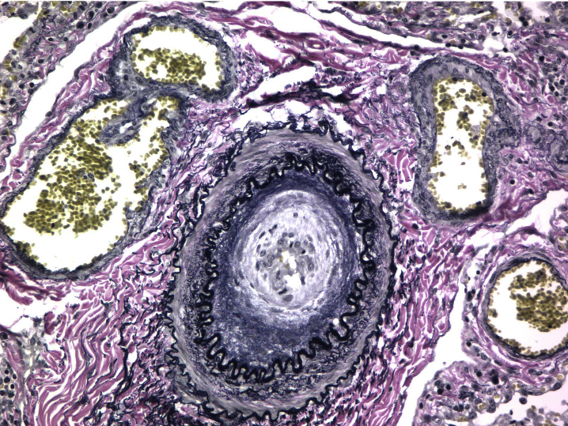
Notes:
COLORS OF THE COLORADO ROCKIES……

Slide 5
Physiology and Treatment of PAH
Endothelin-1
Nitric Oxide
Prostacyclin (PgI₂)
Endothelial cells
Preproendothelin
Proendothelin
L-arginine
Arachidonic acid
Prostaglandin I₂
NOS
Endothelin-1
Nitric oxide
Prostaglandin I₂
Endothelin-receptor A
Endothelin-receptor B
Endothelin-receptor antagonists
cGMP
Exogenous nitric oxide
Prostacyclin derivates
Phosphodiesterase type 5
cAMP
Vasodilatation and antiproliferation
Vasodilatation and antiproliferation
Vasoconstriction and proliferation
sGC Activators and
Stimulators
Phosphodiesterase type 5 inhibitor
Humbert, et al. N Engl J Med. 2004;351:1425-1436.
Notes:
Covers learning objective 1) Utilize knowledge regarding the specific disease pathways for PAH in order to identify the sites and targets for common therapies, including prostacyclin analogs, endothelin receptor antagonists, and phosphodiesterase-5 inhibitors.
The graphic shows three pathways that are believed to play a key role in the pathology of PAH: the endothelin pathway, nitric oxide pathway, and the prostacyclin pathway. The illustration also shows the sites and targets for common treatment options. Endothelin receptor antagonists act on the endothelin receptors in that pathway. The target for the phosphodiesterase-5 inhibitors is the nitric oxide pathway. Meanwhile, the prostacyclin analogs target the prostacyclin pathway.
Notably, none of these pathways reflect more recent insights into the molecular biology and genetics of PAH- re: BMPR2 mutations, cell cycle regulation, metabolic features, inflammatory pathways……. Perhaps a suitable parallel would be in the asthma world, where early on the critical intervention were bronchodilators- prior to modulation of inflammation etc..

Slide 6
Survival in Children with PAH Before and After the Use of Approved Drug Therapies for Adults
2008 Van Loon
2004 Yung
1999 Barst
2010 Ivy
2006 Bosentan
2010 Fraisse
2009 Haworth
2010 Barst
2010 Modeina
2010 Berger
1991 D’Alonzo
2009 Haworth
Survival
2008 Van Loon
1995 Sandoval
1999 Barst
1999 Barst
Historical Controls
1999 Van Loon
1993 Houde
Years
1, 3 and 5 year survival: ~85-95%, 70-95% and 50-95%, respectively
vs prior to therapies: ~40-65%, 45% and 30%
(Robyn Barst, 2012)
Notes:
Source:
1999 Barst (epo indicated but untreated): Circulation 1999;99;1197-12081
1991 D'Alonzo (NIH) : Annals of Internal Medicine. 1991;115:343 1
1999 Barst (epo): Circulation 1999;99;1197-1208
2009 Haworth; IPAH (UK Pediatric PH Center): Heart 2009 95: 312-317
2009 Haworth; APAH (UK Pediatric PH Center): Heart 2009 95: 312-317
2010 Ivy (Denver & Columbia U Pediatric PH Centers): American Journal of Cardiology, in press
2004 Yung (epo): Circulation 2004;110;660-665

Slide 7
Unique Aspects of Pediatric Pulmonary Vascular Disease
Developmental biology of the cardiopulmonary system
Timing of vascular injury during susceptible periods of growth and adaptation
Impact of lung vascular disease beyond PH alone
Differences in genetics/epigenetics, maturational changes in vascular function and growth, co-morbidities and responsiveness to therapeutic strategies
Developmental differences in pharmacokinetics and pharmacodynamics, potential for adverse effects
Additional importance of “preventive” strategies as well as approaches that target “reverse remodeling”
Maturational changes in right and left ventricular function

Slide 8
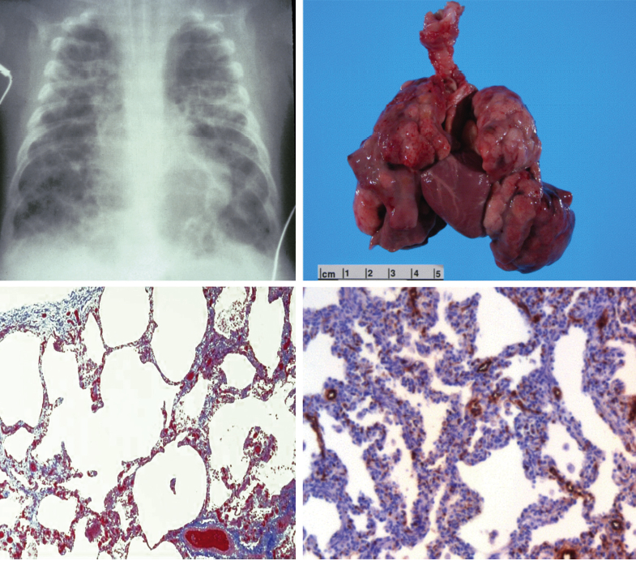
Bronchopulmonary Dysplasia (BPD)
(from Stenmark KR, Abman SH. 2005)

Slide 9
Pulmonary Vascular Disease in BPD
Placental Dysfunction
Epigenetic and Genetic Factors
Premature Birth
Incomplete vascular growth
Immature vascular function
Decreased antioxidant defenses
Lung Injury
Hyperoxia
Mechanical Ventilation
Infection
Inflammation
Hypoxia
Hemodynamics (PDA)
Developing Lung Circulation
Abnormal Structure
Smooth muscle cell and
fibroblast hyperplasia
Altered extracellular matrix
Abnormal Function
High vascular tone
Altered vasoreactivity
Impaired metabolic function
Decreased Growth
Angiogenesis
(Alveolarization)
Notes:
Despite recent advances in the genetics of PAH, little known re: role of genetic variations re: pulmonary circulation in pathobiology of BPD>..

Slide 10
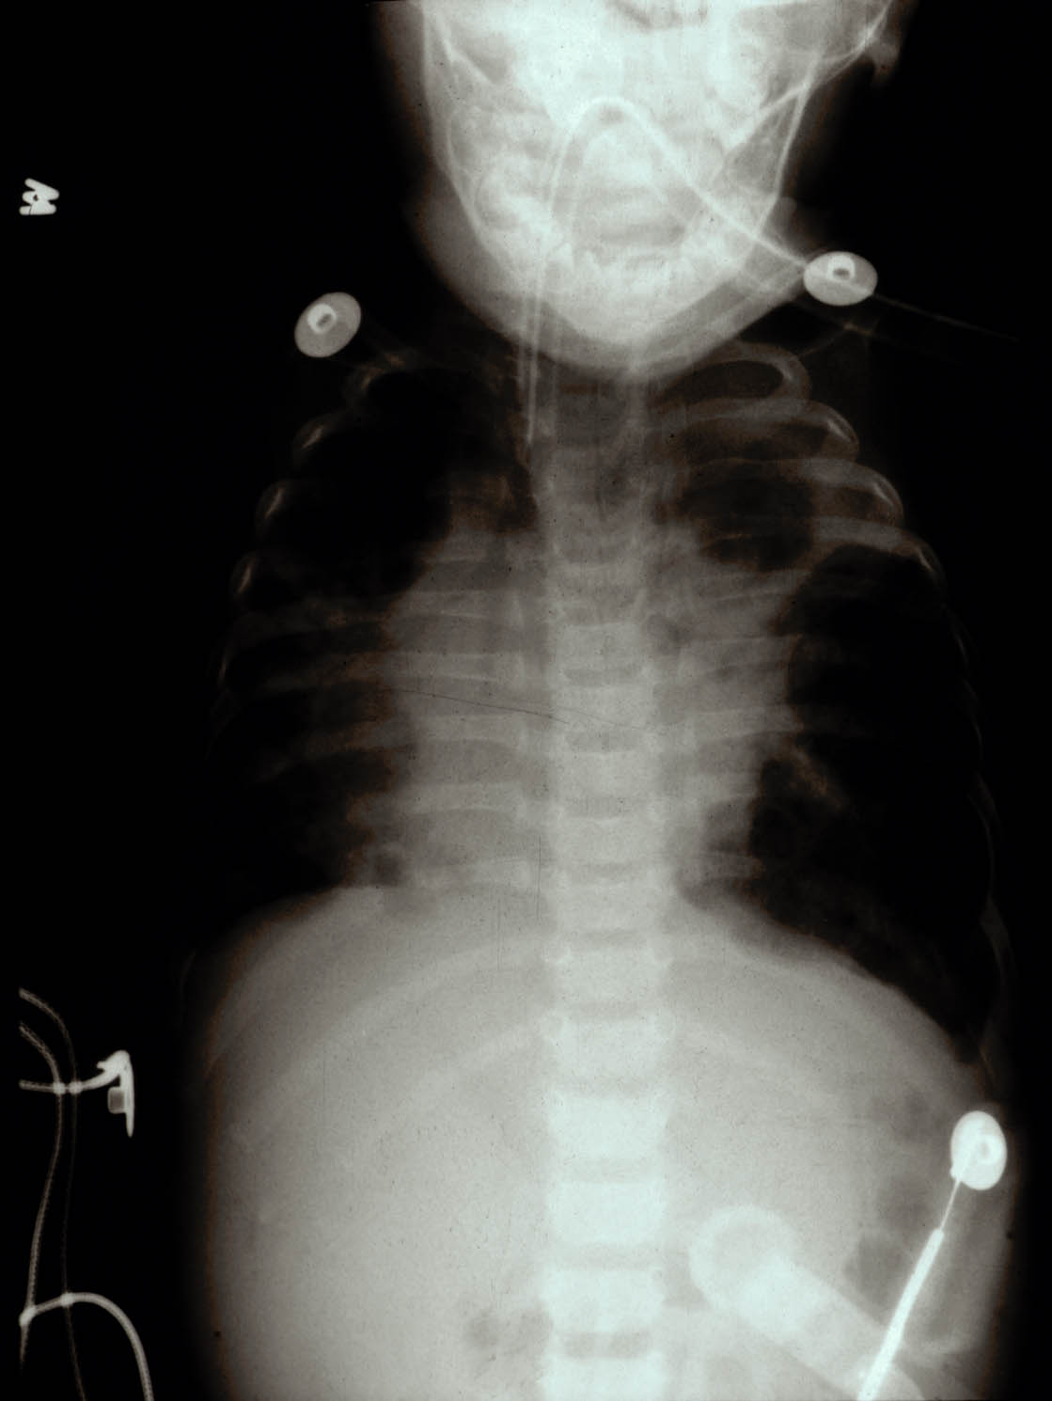

Slide 11
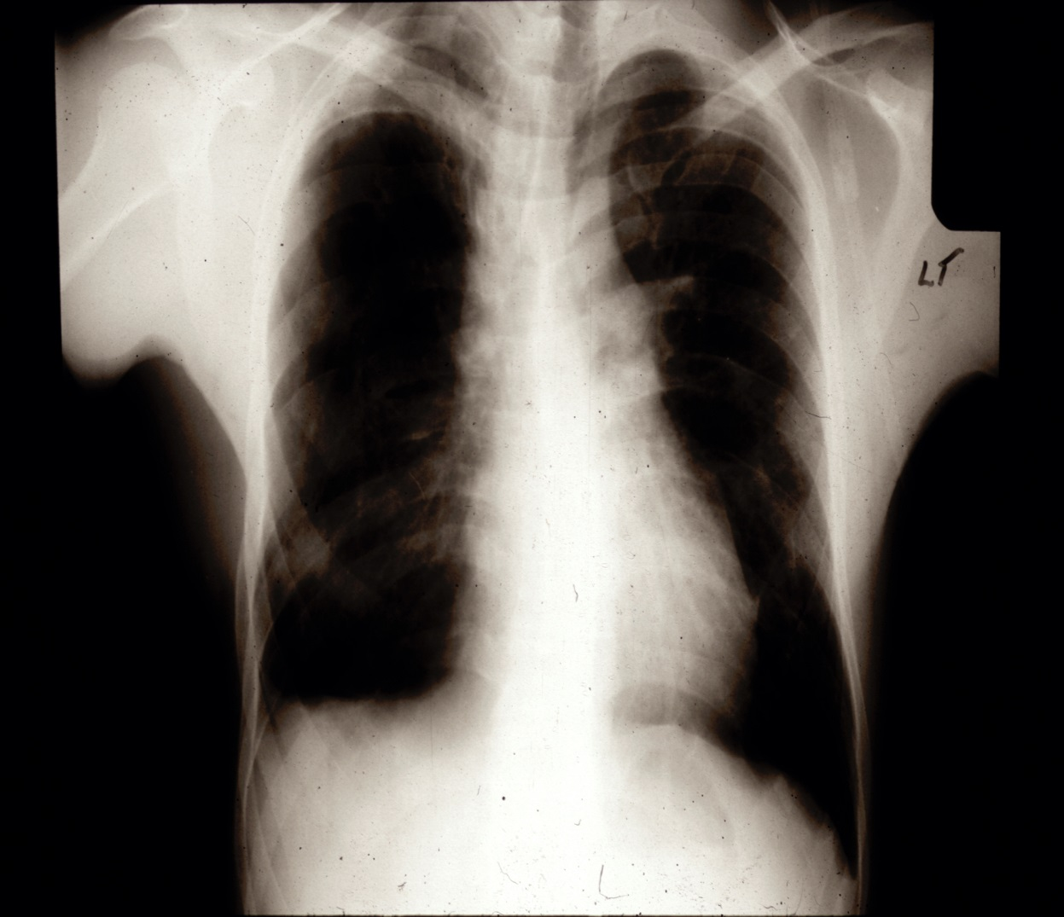
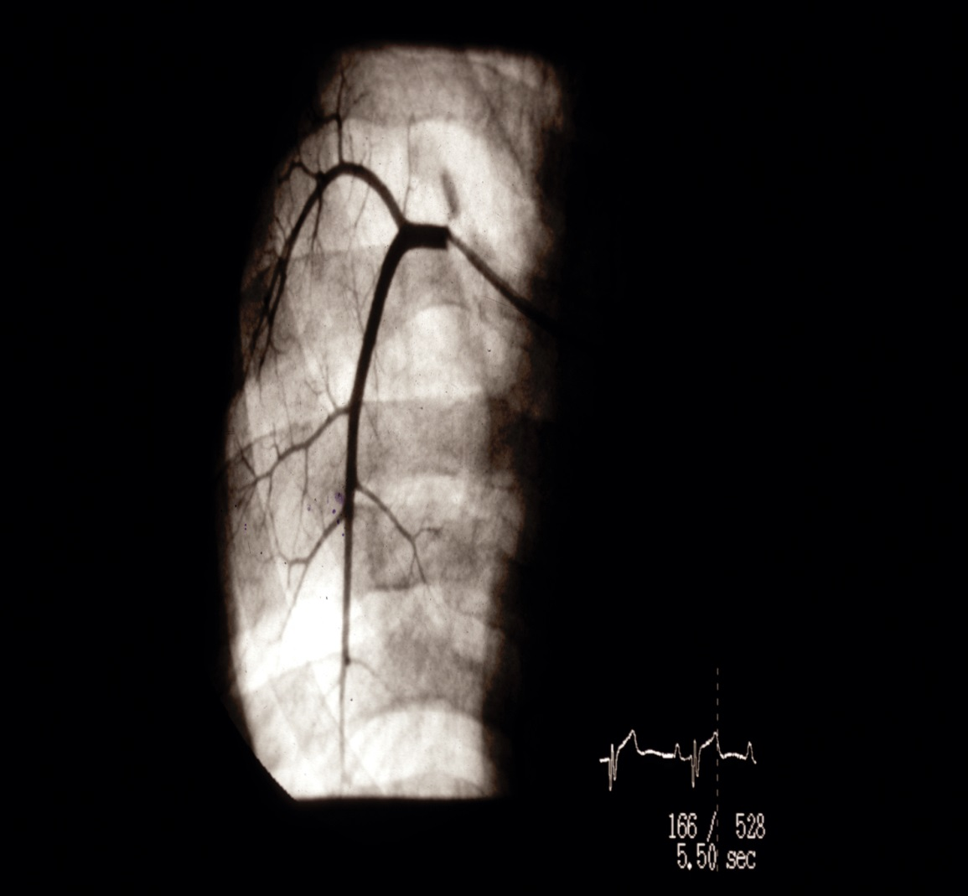
Late Cardiopulmonary Disease in a Young Adult with BPD

Slide 12
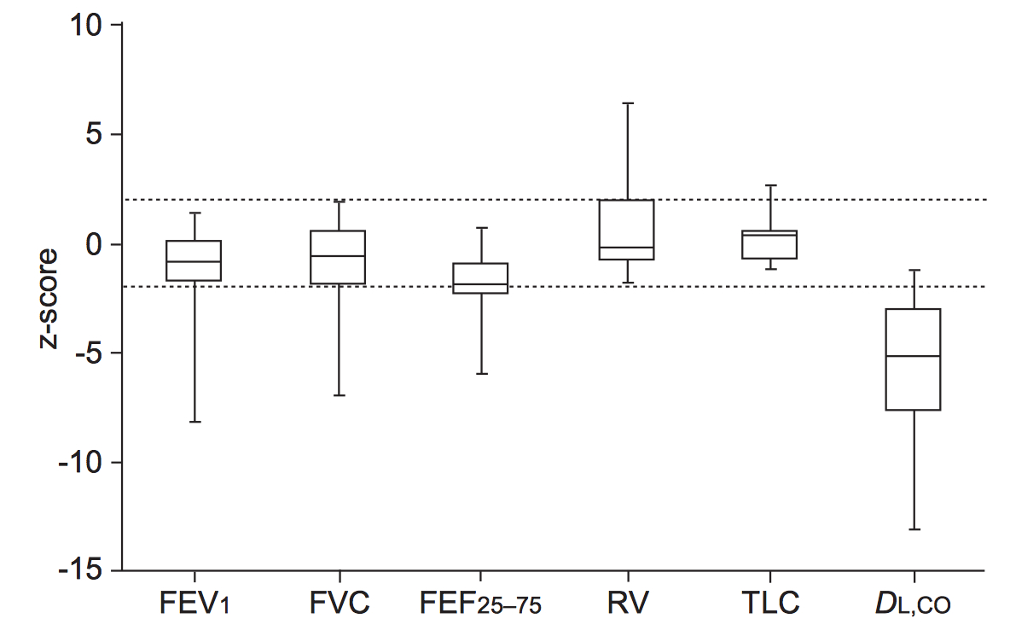
Low D_{L}CO in Adult Survivors of BPD
(Wong PM et al. Eur Respir J, 2008)

Slide 13
Late Pulmonary Hypertension is Associated with Poor Survival in BPD
(from Khemani et al, 2007)

Slide 14
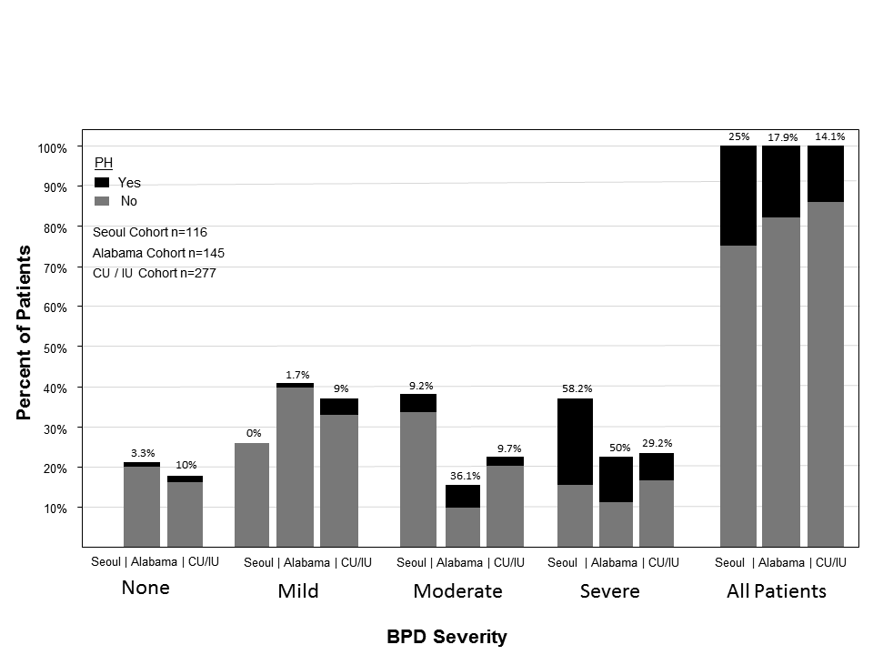
Relationship of PH with Severity of BPD

Slide 15
Issues in the Diagnosis and Management of Pulmonary Hypertension in BPD
Whom to screen?
How to screen?
When to screen?
What is the diagnostic evaluation?
What is the role of cardiac catheterization?
Which therapies are effective in BPD?

Slide 16
Whom to Screen?
Extreme prematurity (< 26 weeks)
IUGR or pre-eclampsia
Maternal smoking
Prolonged ventilator course
Inability to wean FiO₂, lack of overall improvement with time, poor growth, recurrent “spells”
Severity of BPD
Or, All infants with BPD near term corrected age, even if clinically stable?

Slide 17
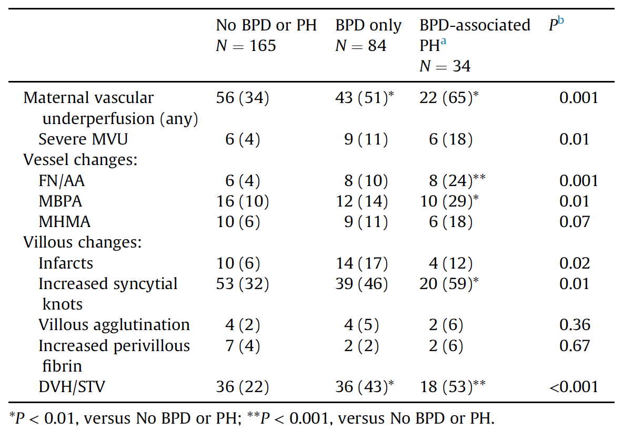
Abnormal Placental Histopathology and High Risk for BPD and PH in Preterm Infants
(MVU = maternal vascular underperfusion)
(Mestan K et al, Placenta, 2014)

Slide 18
Intrauterine Growth Restriction and the Risk of PH in BPD Infants
(Check et al, 2013)

Slide 19
Potential Risk Factors for PH in BPD
 | Minimal Risk | Higher Risks
Gestational Age | > 28 weeks | < 28 weeks
Perinatal risk factors: preeclampsia, chorio, IUGR, maternal smoking | - | +
Echocardiography at dx | Mild septal flattening | RV enlargement, effusion
Pulmonary Vein Stenosis | absent | present
LV Diastolic Dysfunction | LVEDP < 12 | LVEDP > 12
Catheterization: AVT | + reactivity | - reactivity
Catheterization: PVRI, CI, RAP, PA/AoP ratio | PVRI < 7 WU x m²; CI > 3 L/min/m²; RAP < 4 mmHg; Ratio < 0.5 | PVRI > 7 WU x m²; CI < 3 L/min/m²; RAP > 4 mmHg; Ratio > 0.5
NT-pro-BNP | low, decreasing levels | High, sustained levels
Prolonged ventilator tx | Ventilation < 1 month | Ventilation > 1 month
Abbreviations: AVT, acute vasoreactivity testing; BNP, brain natriuretic peptide; CI, cardiac index; dx, diagnosis; LV, Left ventricular;
PVRI, pulmonary vascular resistance index; PA/AoP, pulmonary artery to aortic pressure ratio; RAP, right atrial pressure; RV, right ventricular.

Slide 20
How to Screen?
EKG lacks sensitivity for identifying premature infants at risk for pulmonary hypertension (PH)
Echocardiogram is currently best non-invasive approach, but its efficacy in determining the presence or severity of PH in BPD as applied in clinical practice is uncertain

Slide 21
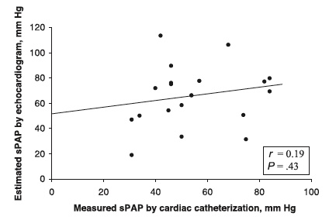
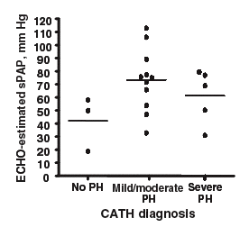
Utility of Echocardiograms in Assessments of Pulmonary Hypertension in BPD
(Mourani et al, Pediatrics, 2008)

Slide 22
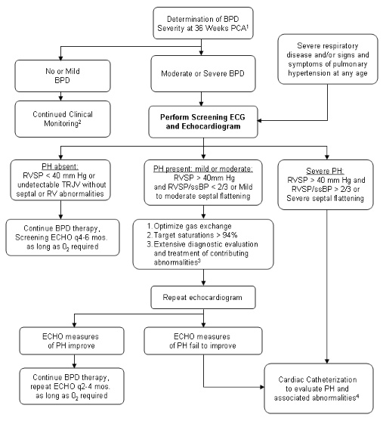
Use of Echocardiography in BPD

Slide 23
Elements of Pulmonary Hypertension in BPD
Lung Disease
Hyperinflation
Atelectasis
Hypoxemia
Hypercarbia
Heart Disease
RV Dysfunction
Impaired LV Contractility
LV Diastolic Dysfunction
Shunt (ASD, PDA, VSD)
High Pulmonary
Artery Pressure
Pulmonary Vascular Disease
High tone and reactivity
Hypertensive arterial remodeling
Decreased vascular growth

Slide 24
Diagnostic Approach to Infants with Pulmonary Hypertension in BPD
Evaluation of Underlying Lung Disease:
Prolonged monitoring of O2 (awake, asleep, feeds)
PaCO2 – contribution to PH or marker of disease severity, need for chronic (effective) ventilation?
Chronic aspiration (barium swallow, swallowing study, pH probe, impedance study)
Sleep study
Structural airway disease: flexible bronchoscopy
Reactive airways disease
Chest CT Scan
Cardiac Catheterization

Slide 25
Role of Cardiac Catheterization
Assess severity of pulmonary hypertension
Anatomic heart disease/shunt lesions (esp. assessment of atrial septal defects)
Structural vascular abnormalities (eg, arterial stenosis, pulmonary vein stenosis, hemangiomatosis, others)
Assess cardiac function (LV dysfunction)
Catheter-based interventions (collaterals, stenosis, shunt)
Acute vasoreactivity/hypoxia testing for selection of chronic therapy

Slide 26
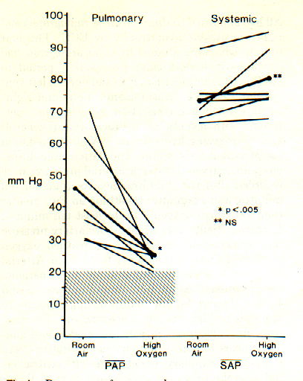
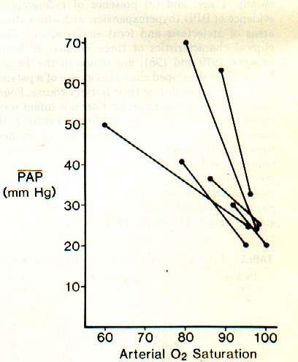
Increased Hypoxic Pulmonary Vasoconstriction in BPD
(Abman et al, 1985)

Slide 27
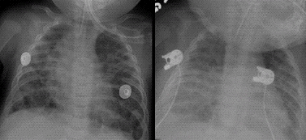
Left Ventricular Diastolic Dysfunction in BPD

Slide 28
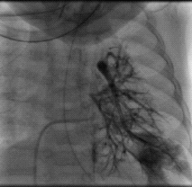
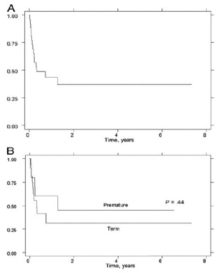
Pulmonary Vein Stenosis in BPD
High Mortality in PVS
(Drossner et al, 2008)

Slide 29
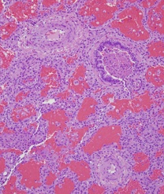
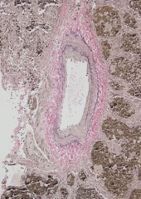
Severe Pulmonary Hypertension in a Preterm Infant with BPD and PVS
Pulmonary Artery Remodeling
Pulmonary Vein Remodeling

Slide 30
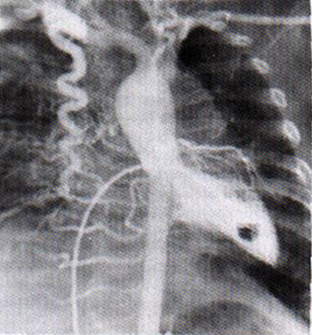
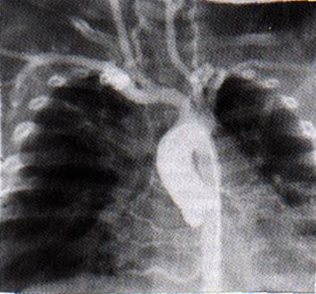
Increased Systemic to Pulmonary Collaterals in BPD

Slide 31
Associated Cardiovascular Lesions in BPD Infants with Pulmonary Hypertension
Finding | % of Patients
PDA/ASD/PFO | 50%
Pulmonary Vein Stenosis | 27%
Aoerto-pulmonary Collaterals | 35%
Left Ventricular End-Diastolic Pressure > 12 mmHg | 54%
Retrospective study of 29 patients
21 patients had CT scans, 14 had cath
66% with one associated findings
(del Cerro et al. Pediatric Pulmonol, 2013)

Slide 32
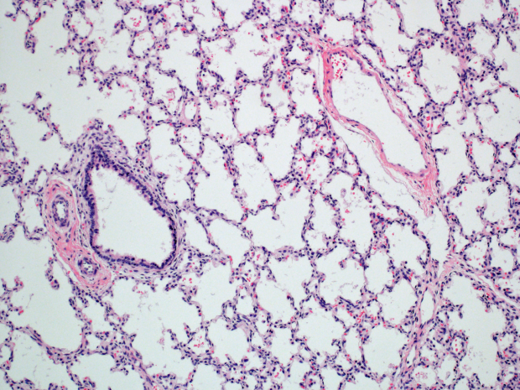
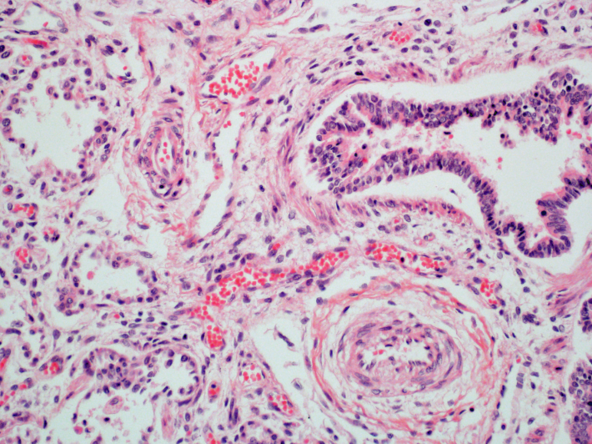
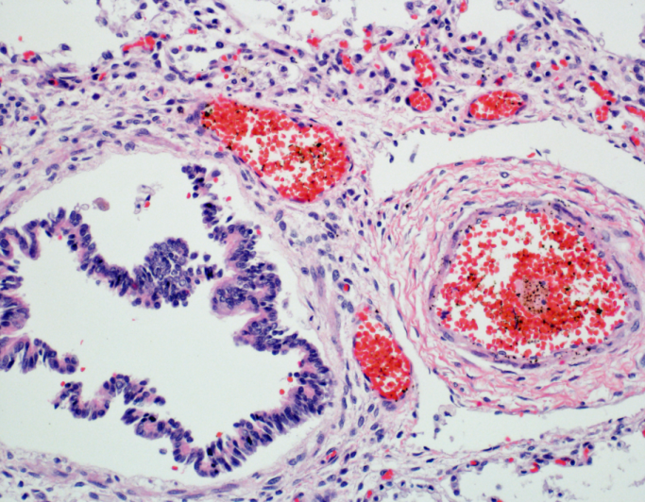
Histologic Evidence of Intrapulmonary Vascular Shunt Vessels in BPD
NORMAL ACD/MPV BPD
V
L
V
A
C
B
A
B
V
A
A
B
C
A
(Galambos C, Sims-Lucas S, Abman SH. Ann Am Thorac Soc. 2013)
Notes:
Figure 1. Prominent blood-filled vascular channels (C) are present within the bronco-arterial bundles in BPD lungs. A: HE stained image of an age matched control lung shows typical position of pulmonary vein (V) that is separated from the neighboring broncho-arterial bundle (B: bronchiole, A: pulmonary artery). Note the lack of prominent vessels other than the pulmonary arteries (A) near the airway (B). B: This normal vascular anatomy is disturbed in ACD lungs where thin walled and blood filled vessels (“misaligned veins”, V) are characteristic findings near pulmonary arteries (A) and bronchiole (B). C: Prominent vascular channels (C) near pulmonary arteries and airways, similar to those seen in ACD are present in lungs of patients with severe BPD (B: bronchiole, A: pulmonary artery, L: lymphatic vessel).

Slide 33
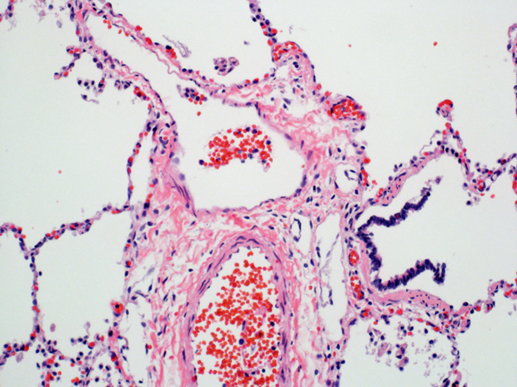
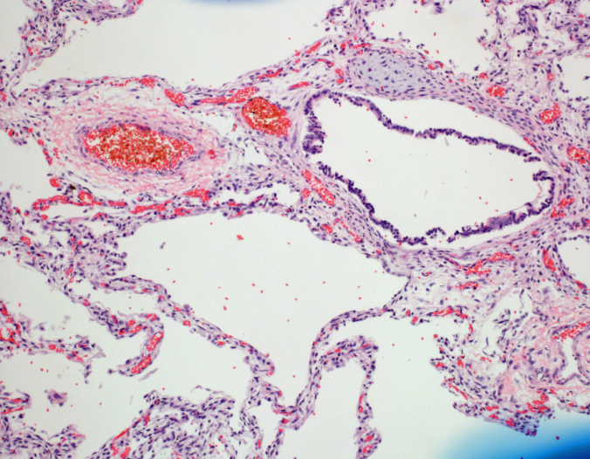
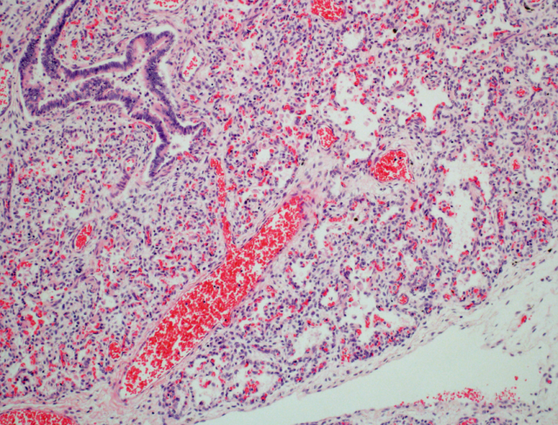
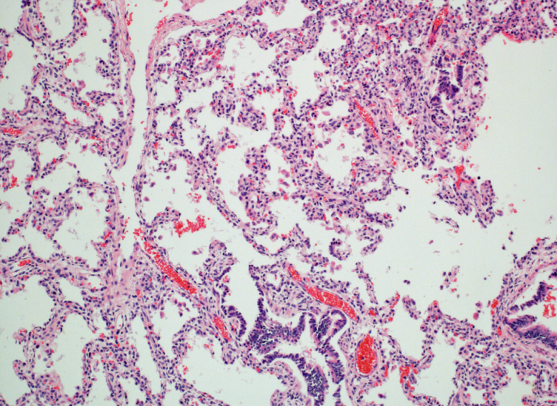
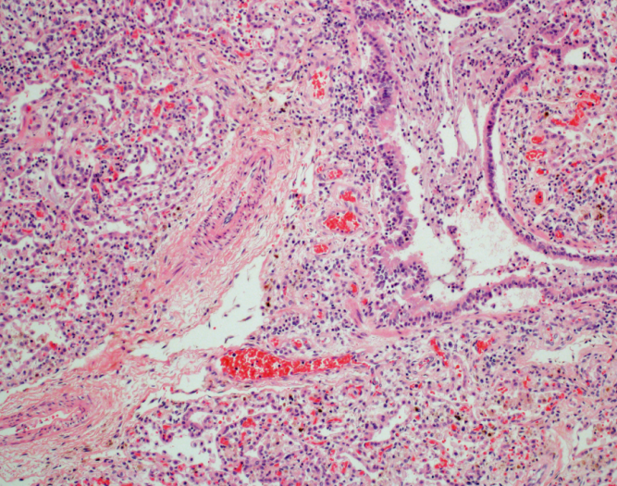
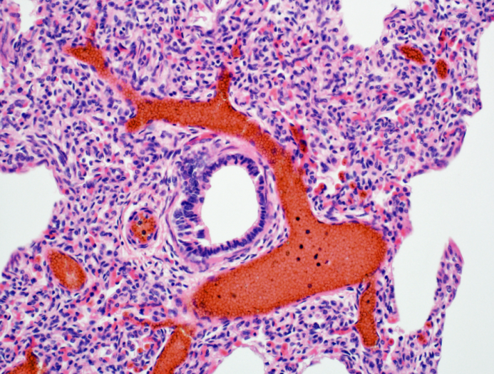
Patterns of Abnormal Vasculature in the Distal Lung of Infants Dying with Severe BPD
A B C
B
A
C
C
A
B
B
L
C
A
L
D E F
A
B
B
L
A
C
C
C
B
A
A
Notes:
Figure 3. Numerous prominent blood-filled vascular channels (C) are present within the bronco-arterial bundles in all lungs of patients with severe BPD (A-F)(B: bronchiole, A: pulmonary artery, L: lymphatic channel).

Slide 34
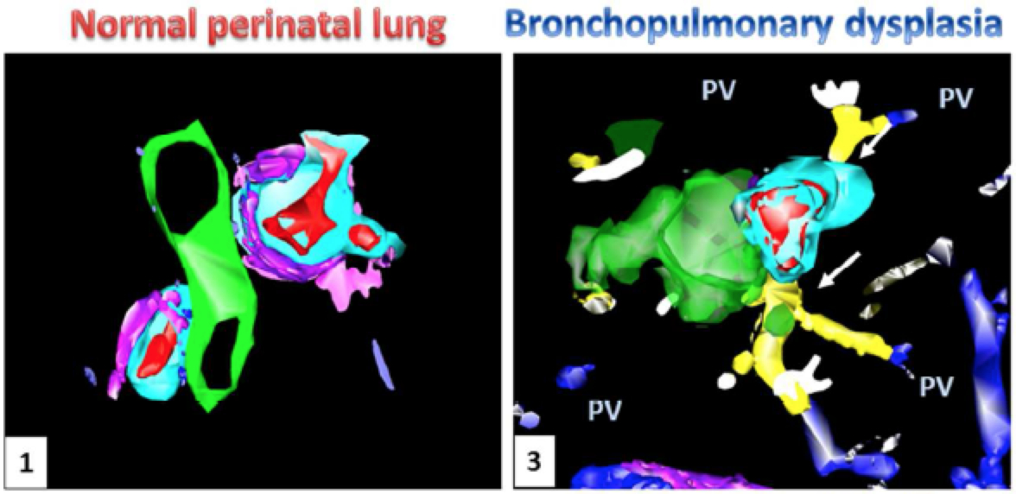
Persistent Fetal Intrapulmonary “Shunt Pathways” in Severe BPD
Artery: red Lymphatic: pink
Veins: blue Art. media: aqua
Airway: green Vascular Channels: yellow
(Galambos C et al. Ann Am Thorac Soc. 2013)
Notes:
Prominent vascular channels (yellow) are present within the bronchoarterial bundles of BPD lungs (artery: red; connecting
vessels: blue, pulmonary veins: blue; airway: green; lymphatic: pink; arterial muscular wall: aqua), but not in the control lungs.
These vascular channels appear to course toward the vessels located within the interlobular septa (pulmonary veins, PV) and make contact with the microvessels

Slide 35
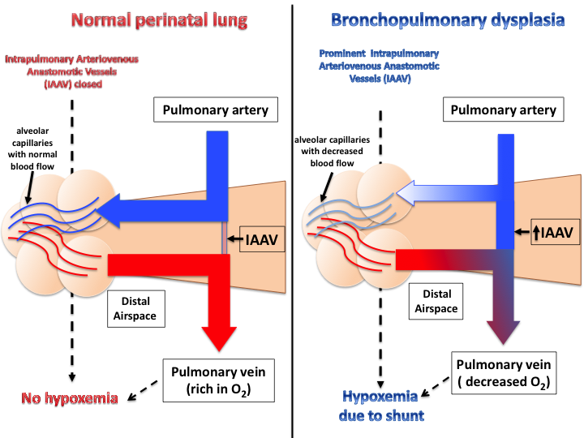
Intrapulmonary Shunt Vessels in BPD
(Galambos C et al. Ann Am Thorac Soc. 2013)

Slide 36
Pulmonary Hypertension Drugs: Therapeutic Approach in BPD
Inhaled NO (5 - 20 ppm)
Sildenafil (0.5 -2 mg/kg/dose q 6 - 8 hours)
Bosentan (1/4 tab daily initially, then BID)
Prostacyclin analogues:
Epoprostenol (Flolan) (iv)
Inhaled Iloprost
Remodulin (iv, SQ, inhaled)
Milrinone

Slide 37
AHA/ATS Consensus Pediatric PAH Treatment Algorithm
Consider: Diuretics, Oxygen, Anticoagulation, Digoxin
Acute Vasoreactivity Testing
Positive
Negative
Oral CCB
Lower Risk
Higher Risk
No
ERA or PDE-5i (oral)
Iloprost (inhaled)
Treprostinil (inhaled)
Epoprostenol IV or
Treprostinil (IV/SQ)
Consider Early Combination
ERA or PDE-5i (oral)
Improved
Yes
Reassess: consider combo-therapy
Atrial septostomy Lung transplant
Continue CCB
Ambrisentan (2aB), Bosentan (1B), CCB (1B), Epoprostenol (1B), Iloprost (2aB), Sildenafil (1B), Tadalafil (2aB), Treprostinil IV/SQ (1B),
Treprostinil Inh (2aB)
Modified from J Am Coll Cardiol. 2009;53:1573-1619.
Notes:
This slide is an algorithm of treatment options based on assessment of a patient’s risk status.
Background therapies include warfarin anticoagulation, which is recommended in all patients with IPAH without contraindication. Diuretics are used for management of right heart failure. Oxygen is recommended to maintain oxygen saturation > 90%.
Acute vasodilator testing should be performed in all IPAH patients who may be potential candidates for long-term therapy with calcium channel blockers (CCBs). Patients with PAH due to conditions other than IPAH have a very low rate of long-term responsiveness to oral CCBs, and the value of acute vasodilator testing in such patients needs to be individualized. IPAH patients in whom CCB therapy would not be considered, such as those with right heart failure or hemodynamic instability, should not undergo acute vasodilator testing. †CCBs are indicated only for patients who have a positive acute vasodilator response, and such patients need to be followed closely both for safety and efficacy.
For patients who did not have a positive acute vasodilator testing and are considered lower risk based on clinical assessment, oral therapy with ERA or PDE-5I would be the first line of therapy recommended. If an oral regimen is not appropriate, the other treatments would need to be considered based on patient's profile and side effects and risk of each therapy. The endothelin receptor antagonists are oral therapies that improve exercise capacity in PAH. Liver function tests must be monitored indefinitely on a monthly basis. Phosphodiesterase inhibitors also improve exercise capacity.
For patients who are considered high risk based on clinical assessment, continuous treatment with intravenous (IV) prostacyclin (epoprostenol or treprostinil) would be the first line of therapy recommended. If a patient is not a candidate for continuous IV treatment, the other therapies would have to be considered based on patient's profile and side effects and risk of each treatment. Epoprostenol improves exercise capacity, hemodynamics, and survival in IPAH and is the preferred treatment option for the most critically ill patients. Although expensive and difficult to administer, epoprostenol is the only therapy for PAH that has been shown to prolong survival. Treprostinil may be delivered via either continuous IV, subcutaneous (SC) infusion, or a unique aerosolizing device 4 times daily. Iloprost is a prostacyclin analogue delivered by an adaptive aerosolized device 6 times daily.
Combination therapy should be considered when patients are not responding adequately to initial monotherapy.
Timing for lung transplantation and/or atrial septostomy is challenging and is reserved for patients who progress despite optimal medical treatment.

Slide 38
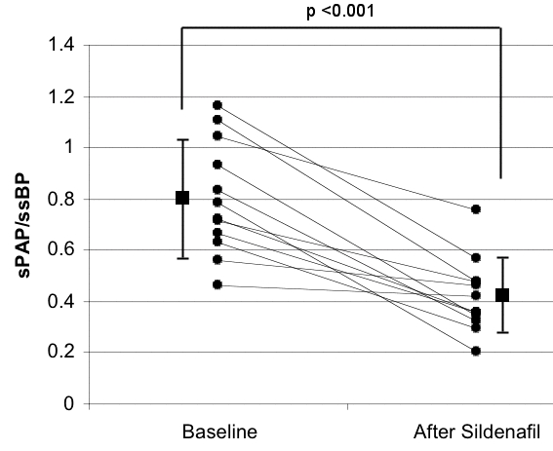
Chronic Sildenafil Therapy for Late Pulmonary Hypertension in CLD
(Mourani PM et al, J Peds, 2009 )

Slide 40
Dose-Related Late Mortality in the Pediatric Sildenafil Study
(from the Food and Drug Administration)

Slide 41
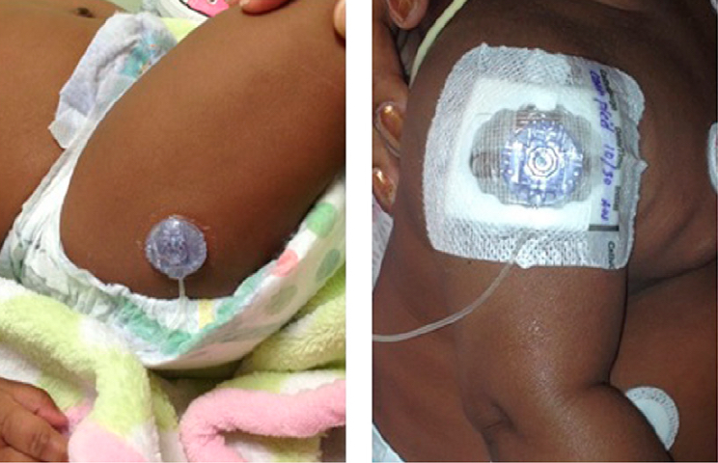
Subcutaneous Treprostinil (Remodulin) for Late Pulmonary Hypertension in BPD
(Ferdman DJ et al. Pediatrics 2014)

Slide 42
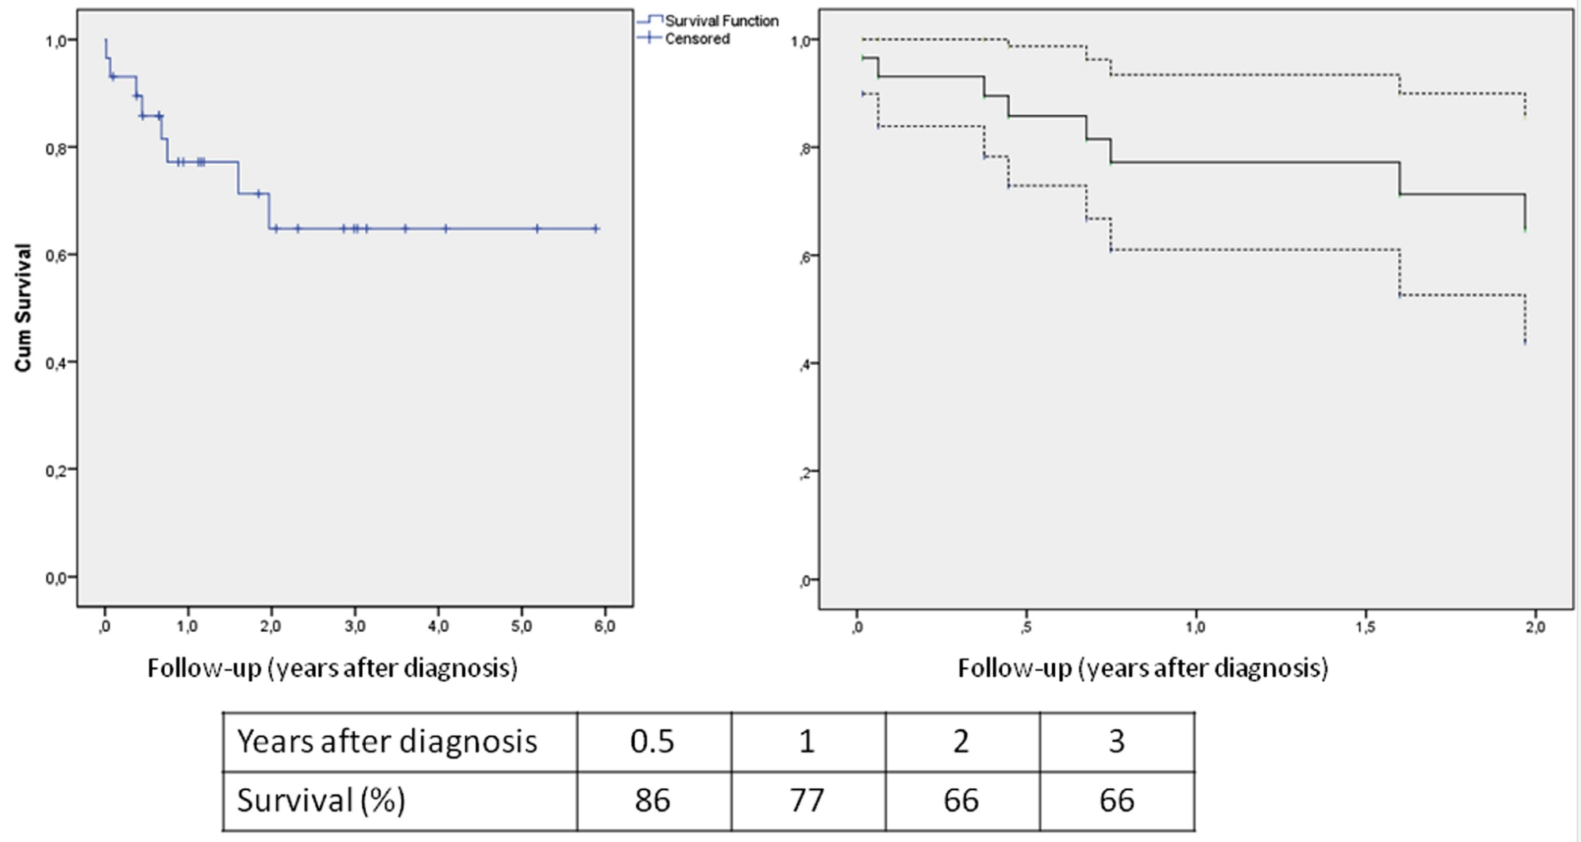
Poor Survival in BPD Infants with Pulmonary Hypertension
(Del Cerro et al. Pediatric Pulmonol, 2013)
* 95% Confidence Intervals

Slide 43
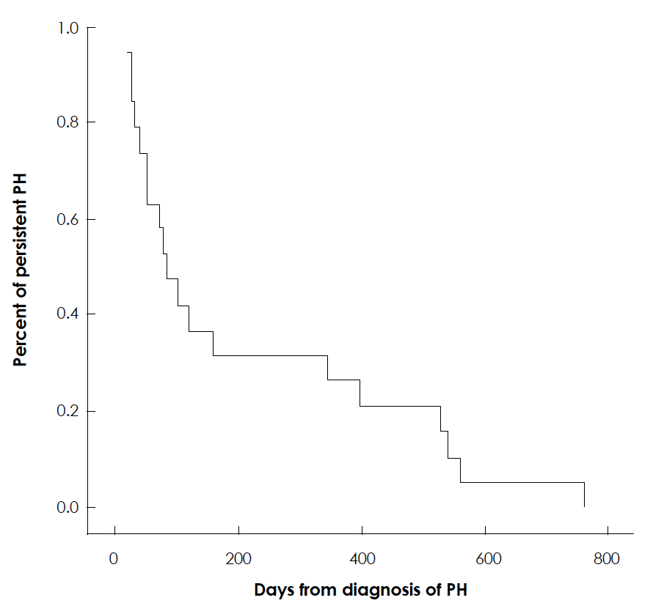
Resolution of Pulmonary Hypertension in BPD
29 patients with PH and BPD
69% on drug therapy:
- inhaled NO (45%)
- sildenafil (62%)
- bosentan (10%)
- iloprost (14%)
14% mortality
(An et al, Korean Circ J, 2010)

Slide 44
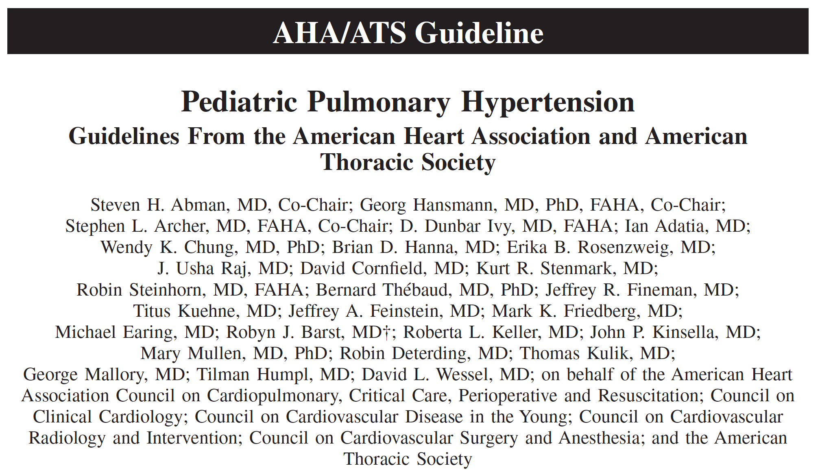
(Circulation, 2015)

Slide 45
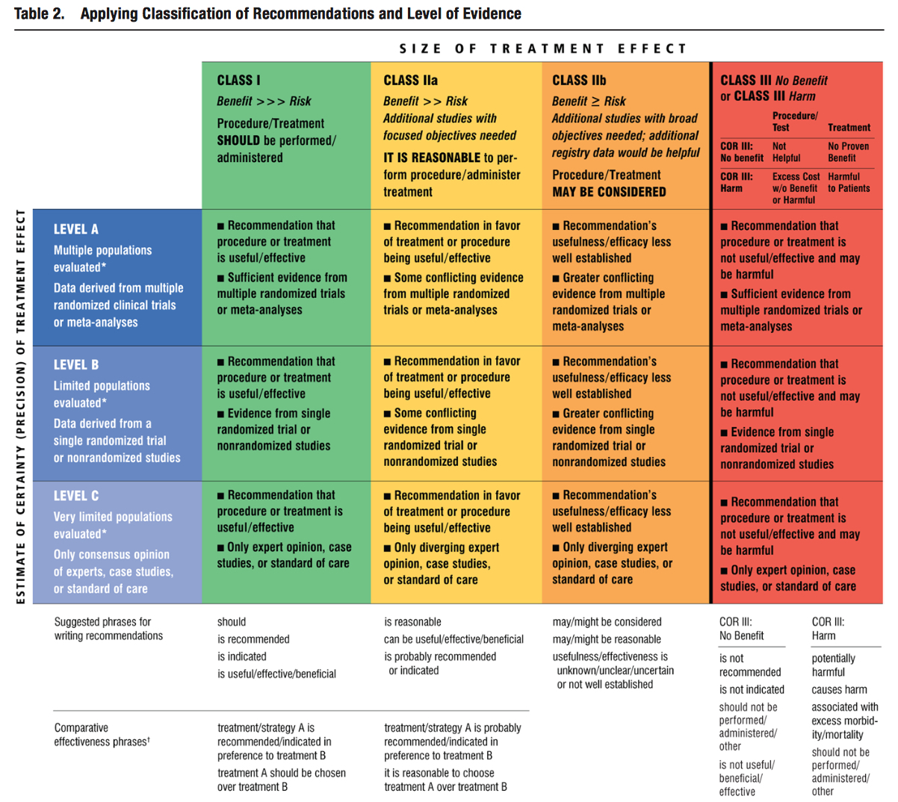
AHA/ATS Joint Guidelines for Pediatric PH
Class
Level

Slide 46
Pulmonary Hypertension in BPD
Screening for PH by echocardiogram is recommended in infants with established BPD (Class I, Level B).
Evaluation and treatment of lung disease, including assessments for hypoxemia, aspiration, structural airways disease and the need for changes in respiratory support, is recommended in infants with BPD and PH before initiation of PAH-targeted therapy. (Class I, Level B)

Slide 47
Pulmonary Hypertension in BPD
Evaluation for chronic therapy for PH in infants with BPD should follow recommendations for all children with PH and include cardiac catheterization to diagnose disease severity and potential contributing factors such as LV diastolic dysfunction, anatomic shunts, pulmonary vein stenosis and systemic collaterals. (Class I, Level B)
Supplemental oxygen therapy is reasonable to avoid episodic or sustained hypoxemia and with the goal of maintaining O2 saturations between 92% - 95% in patients with established BPD and PH. (Class IIa, Level C)
PAH-targeted therapy can be useful for infants with BPD and PH on optimal treatment of underlying respiratory and cardiac disease. (Class Ila, Level C)

Slide 48
Conclusions
Pulmonary vascular disease (PVD) can be identified early in preterm newborns and is associated with:
An increased risk for developing BPD
Higher mortality and late respiratory morbidities.
Primary management is related to comprehensive evaluation and treatment of underlying respiratory disease
PH and related cardiovascular abnormalities modulate the clinical course and outcomes of BPD.

Slide 49
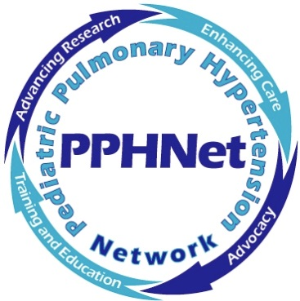
Pediatric Pulmonary Hypertension Network (PPHNet)
Dunbar Ivy Mary Mullen Erika Berman-Rosenzweig Jeff Fineman Brian Hanna
(Colorado) (Boston) (Columbia) (UCSF) (CHOP)
Eric Austin Tilman Humpl Jeff Feinstein Ian Adatia Allen Everett
(Vanderbilt) (Toronto) (Stanford) (Alberta) (Hopkins)

Slide 50
Q&A

